Slide 1
LEAD SCORE CASE STUDY
Present By :
Saharish Rida
Parvani Mohokar
Bhuvaneshwari Raja
Swati

Slide 2
PROBLEM STATEMENT
X Education Company wishes to identify the most potential leads, also known as "Hot Leads". Hot Leads are basically the people who are engaging with the company's website/videos/sales calls and have high probability of converting into customers of X Education Company, thus bringing revenue to the company.
To improve lead conversion, the company is keen on selecting the most promising leads from the various channels through which leads are generated, including email, website advertisements, and Google searches.
Despite generating a significant number of leads, X Education faces challenges in efficiently converting them into paying customers. Currently, the company experiences a 30% conversion rate throughout the process of turning leads into customers
Expectations from case study:
Identify most potential leads and increase conversion rate
Build model with assignment of lead score to selected leads, higher score means higher chances of conversion.
Target Lead conversion rate to be around 80%

Slide 3
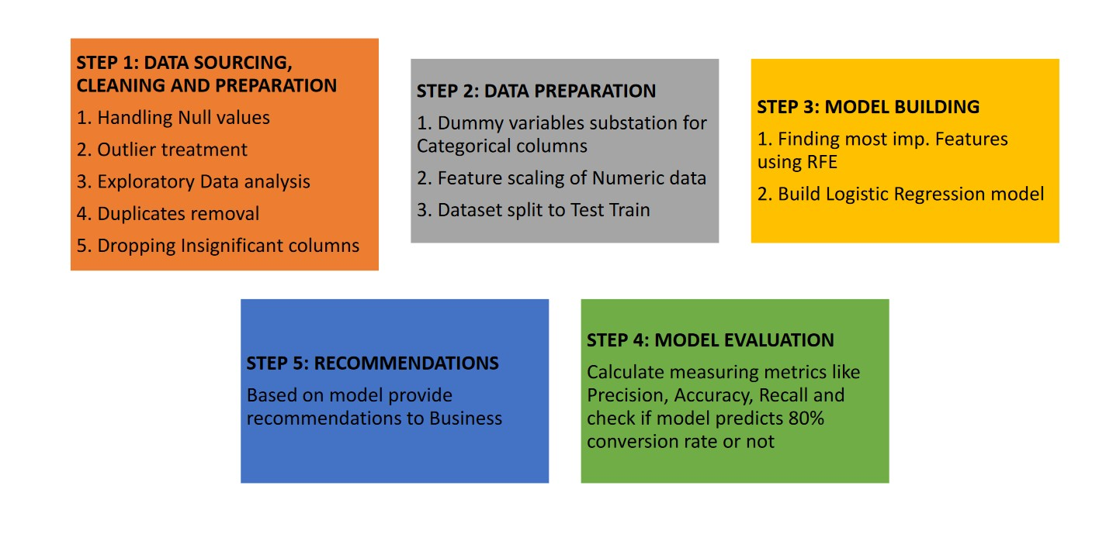
APPROACH TO SOLUTION

Slide 4
STEP 1: DATA SOURCING, CLEANING AND PREPARATION
Basic Metadata check
a) .shape function: 9240 rows x 37 columns
b) .info() function: Information
c) .describe() function :Descriptive Statistics: To check for probable outliers
➢ Data wrangling
Identify gaps in data and either fill them or delete them
Deleting data that is either unnecessary or irrelevant
Identify extreme outliers and deal with them
➢ Duplicate values:
Check for Duplicate values/columns and drop it: Prospect ID, Lead number S
➢ Check for Null values and Handle the same
Finding null values using .isnull().sum() function
‘Select’ replaced by NaN values
Dropped columns with Null values ≥39%
Imputation of Null values:
✓ Categorical columns: Replaced null values by missing
✓ Numeric columns: Imputation with median value e.g Total visits column
➢ Outlier treatment:
By use of descriptive statistics analysis. Columns treated are Total visits and Pages views per visit
➢Column dropping criteria:
Columns which has only one category are dropped as inferences cannot be done
Removed Country column as 60% data is related to ‘India’ and rest data is missing.
Checked for Data Imbalance and removed columns if that is insignificant. Dropped columns ‘Do not Email’, ‘ Digital Advertisement’, ‘Through Recommendations’ etc. as they found insignificant based on EDA analysis.
Last Notable activity and Last Activity columns are redundant to each other, hence dropped ‘Last Activity’ column.

Slide 5
EXPLORATORY DATA ANALYSIS

Slide 6
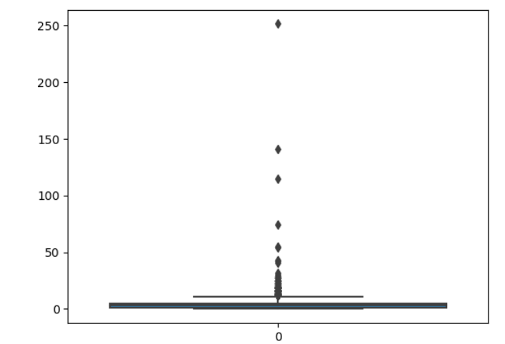
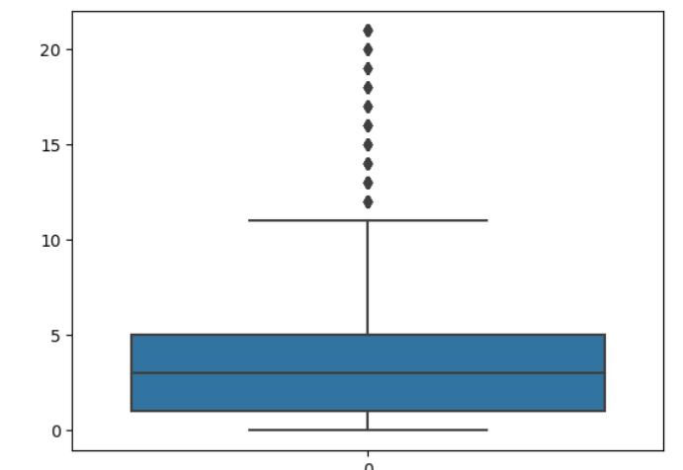
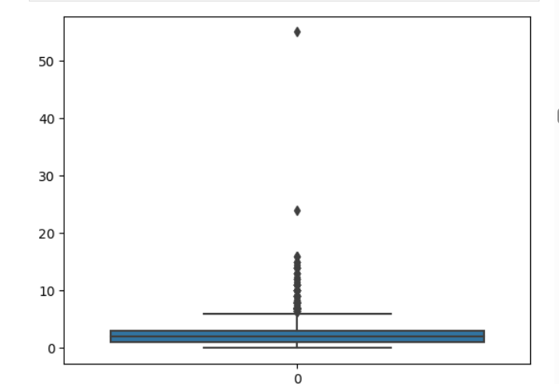
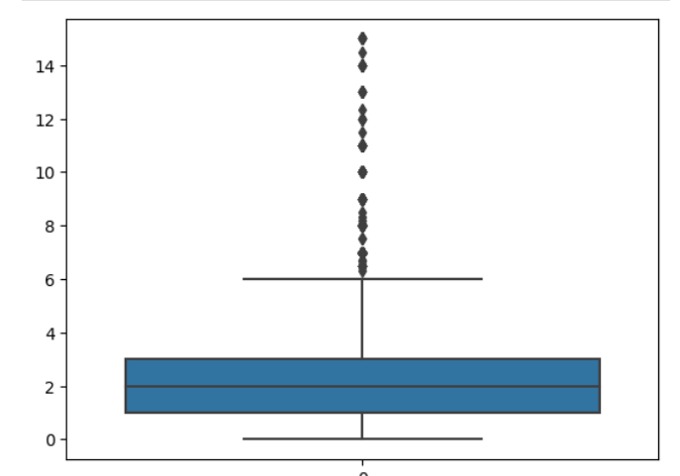
EDA - OUTLIER TREATMENT
"TotalVisits"
"TotalVisits"
"Page Views Per Visit"
"Page Views Per Visit"

Slide 7
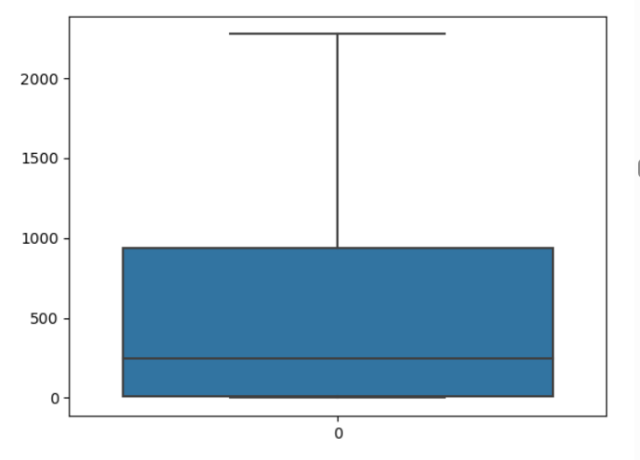
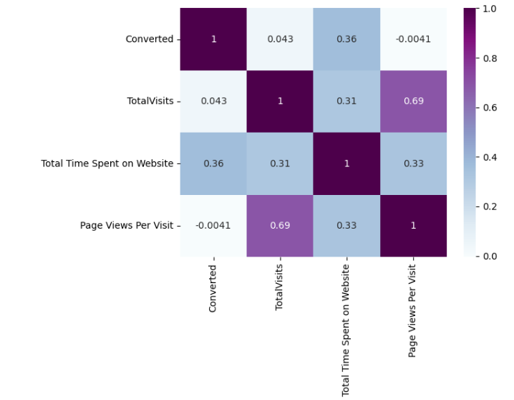
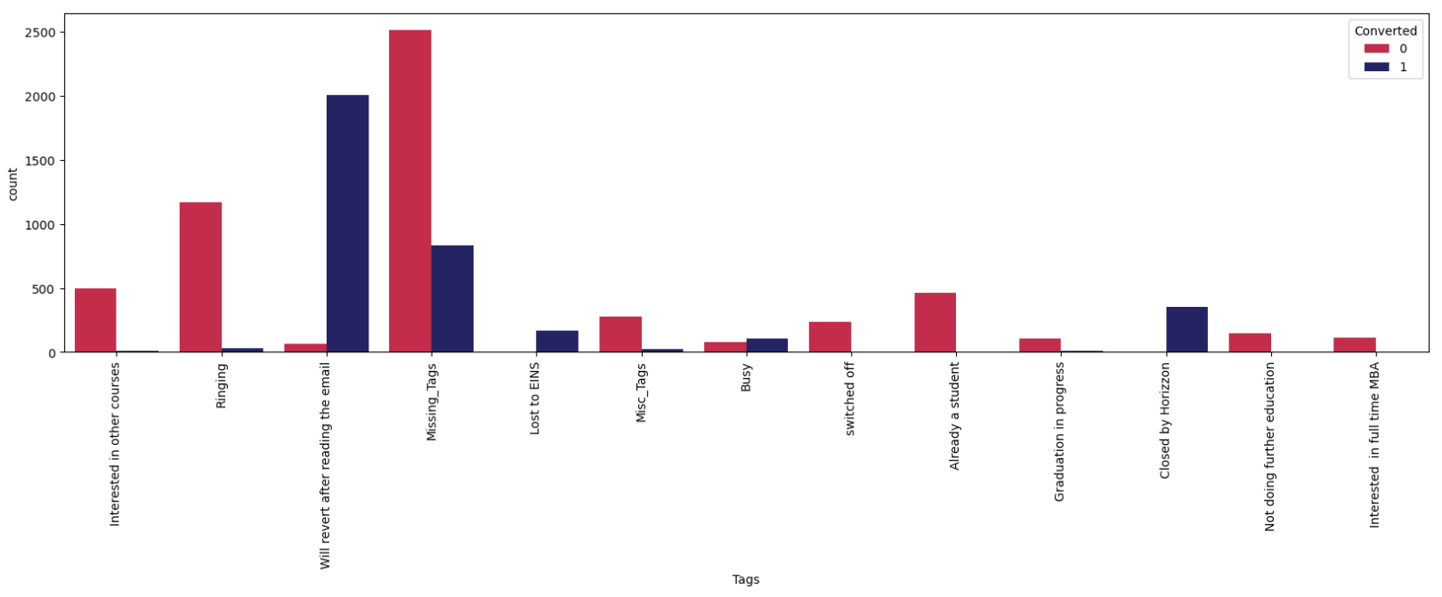
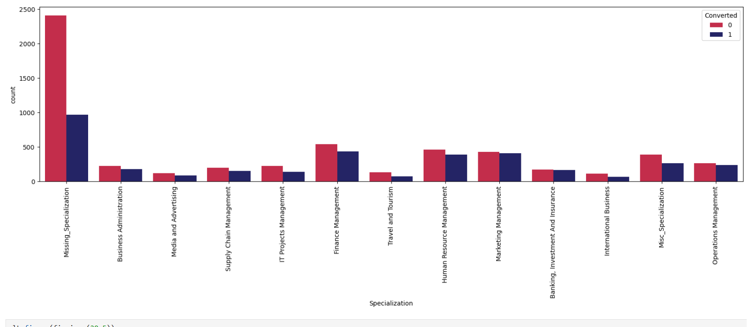
EDA – NUMERICAL COLUMNS
Positive correlation observed in TotalVisits and Page Views Per Visit.
EDA: BIVARIATE ANALYSIS OF CATEGORICAL COLUMNS
Total Time Spent on Website
Positive conversion rate is observed in "Finance Management", "Human Resouce Management", "Marketing Management","Operations Management" specialization

Slide 8
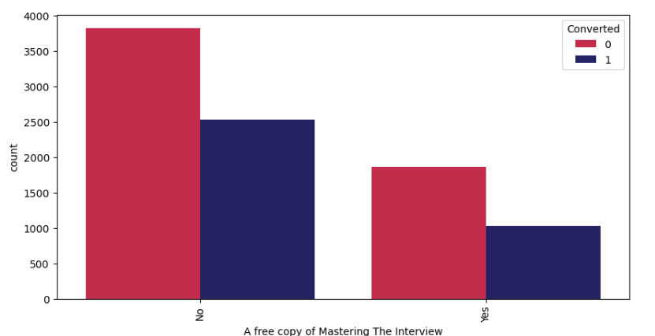
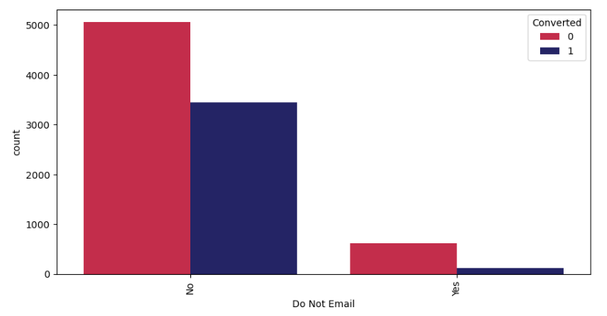
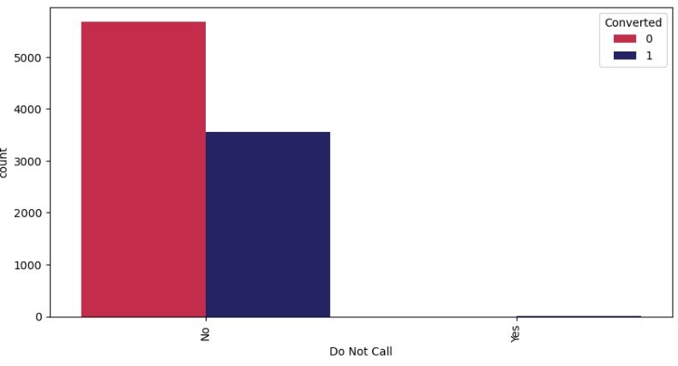
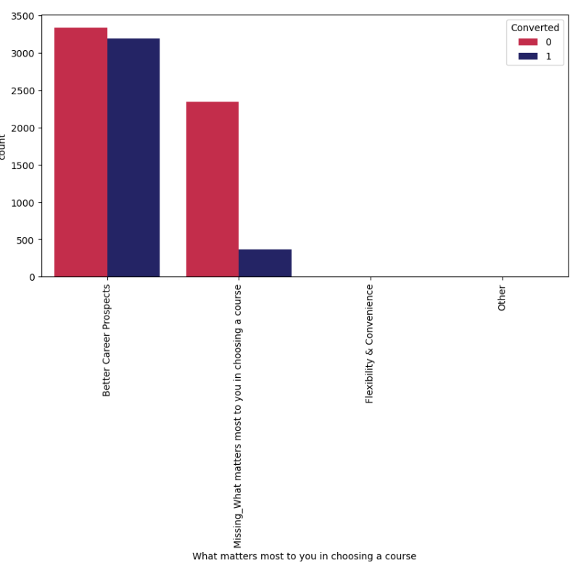
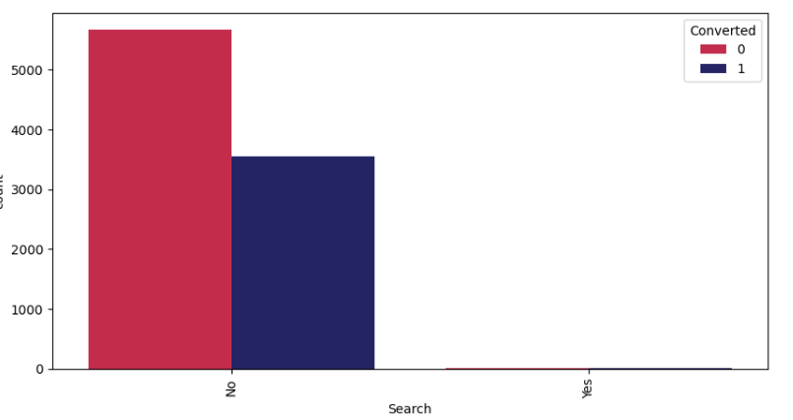
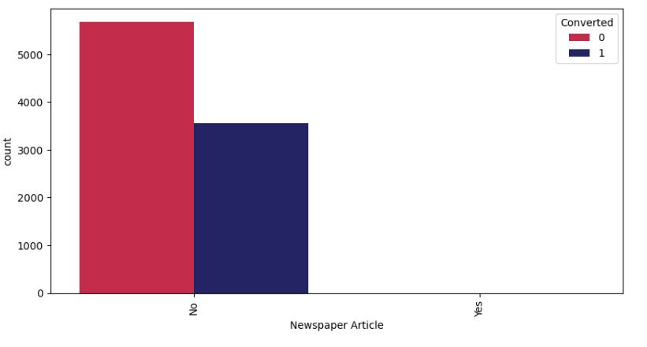
EXAMPLES OF DATA IMBALANCE AND INSIGNIFICANT COLUMNS
SIGNIFICANT COLUMNS
Positive conversion rate observed in both the categories.
Positive conversion rate observed with the motive to improvise career prospects

Slide 9
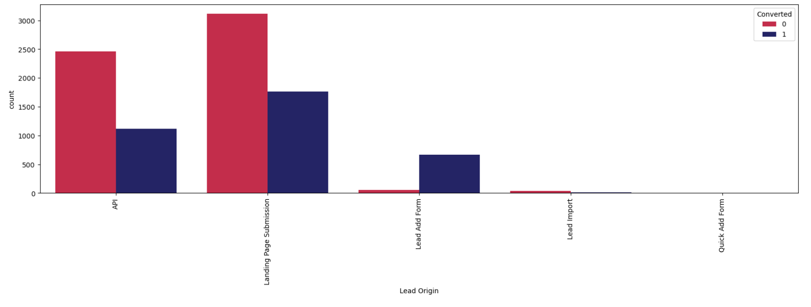
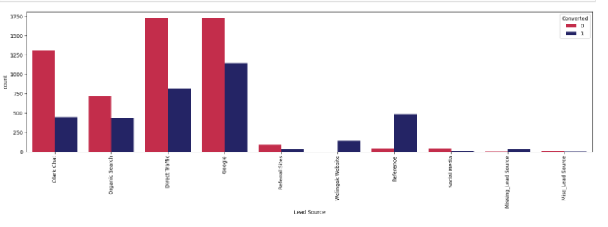
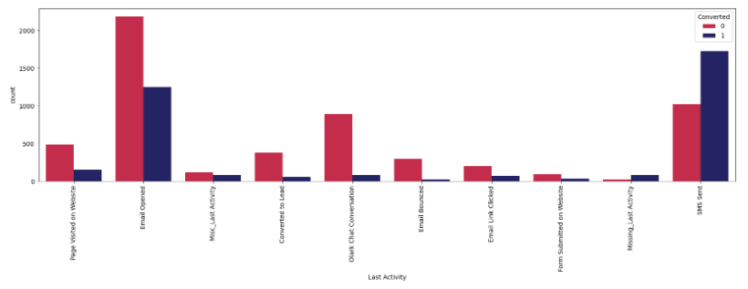
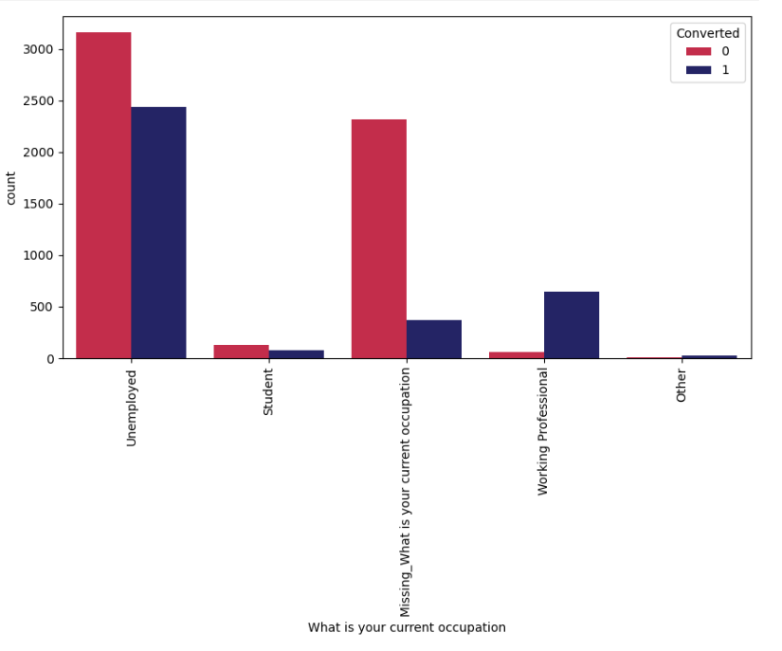
SIGNIFICANT COLUMNS
Positive conversion rate observed in "Landing Page Submission", followed by "API" Lead Origin.
Positive conversion rate noticed in "Google" and "Direct Traffic"
Positive conversion rate observed in unemployed applicants

Slide 10
STEP 2: DATA PREPARATION
➢ Prepared Dummy variables for Categorical columns and Dropped original columns
➢ Concatenated Dummy variables dataset and Lead dataset
➢ Test-Train data split: Test dataset: Train dataset
➢ Target variable = Converted
➢Feature scaling using MinMaxScaler() function
➢ fit_transform() applied to numerical columns of Train data
STEP 3: MODEL BUILDING AND FITTING
➢ Applied : LogisticRegression ,Naïve Bayes and Decision Tree
STEP 4: MODEL EVALUATION
➢ Confusion matrix, Classification report, accuracy, precision, recall
➢ Model finalization and check fit for Test dataset
➢ Difference between Train and Test data should be <5%

Slide 11
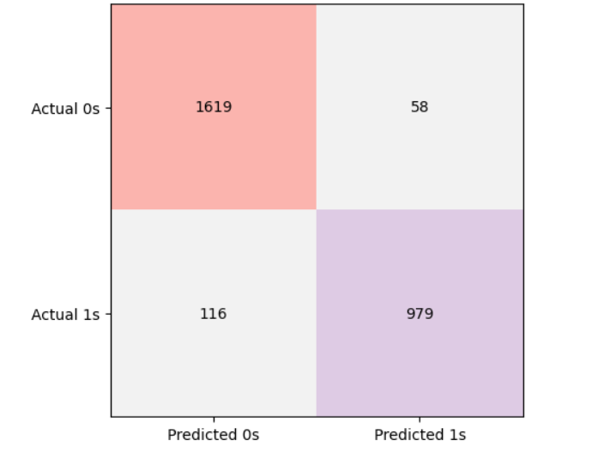
LOGISTIC REGRESSION
MODEL EVALUATION – CONFUSION MATRIX
CLASSIFICATION REPORT
 | Precision | Recall | F1-Score | Support
0 | 0.93 | 0.97 | 0.95 | 1677
1 | 0.94 | 0.89 | 0.92 | 1095
Accuracy |  |  | 0.94 | 2772
Macro Avg | 0.94 | 0.93 | 0.93 | 2772
Weighted Avg | 0.94 | 0.94 | 0.94 | 2772
Best Model Fit Accuracy : 94 % Logistic Regression

Slide 12
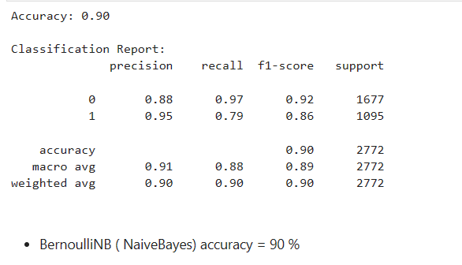
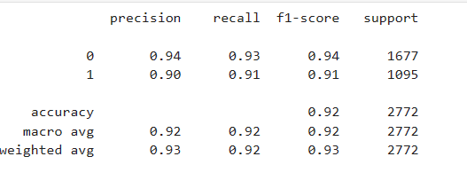

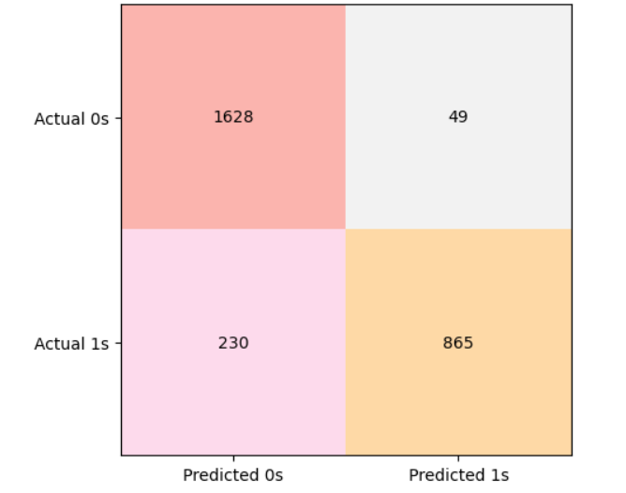
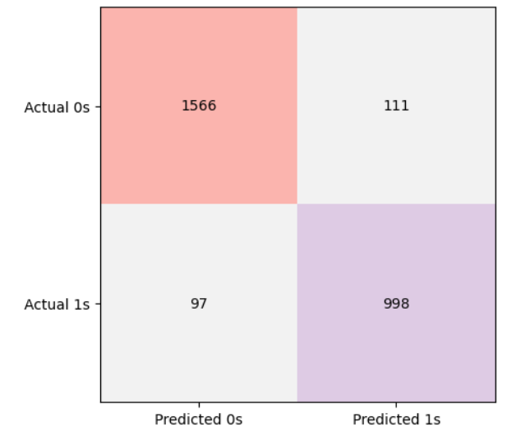
NAÏVE BAYES
DECISION TREE

Slide 13
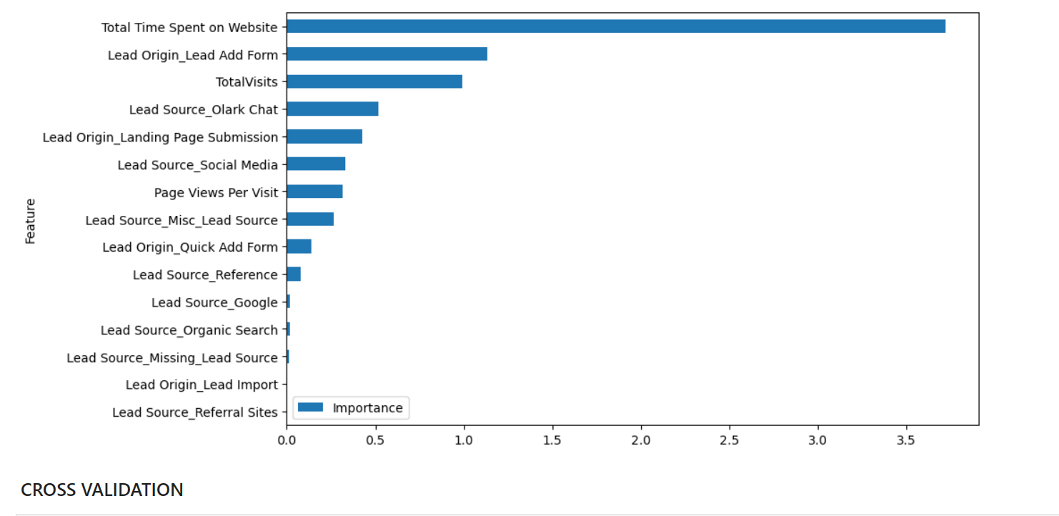
BUSINESS RECOMMENDATIONS

Slide 14
THANK YOU

